Slide 1
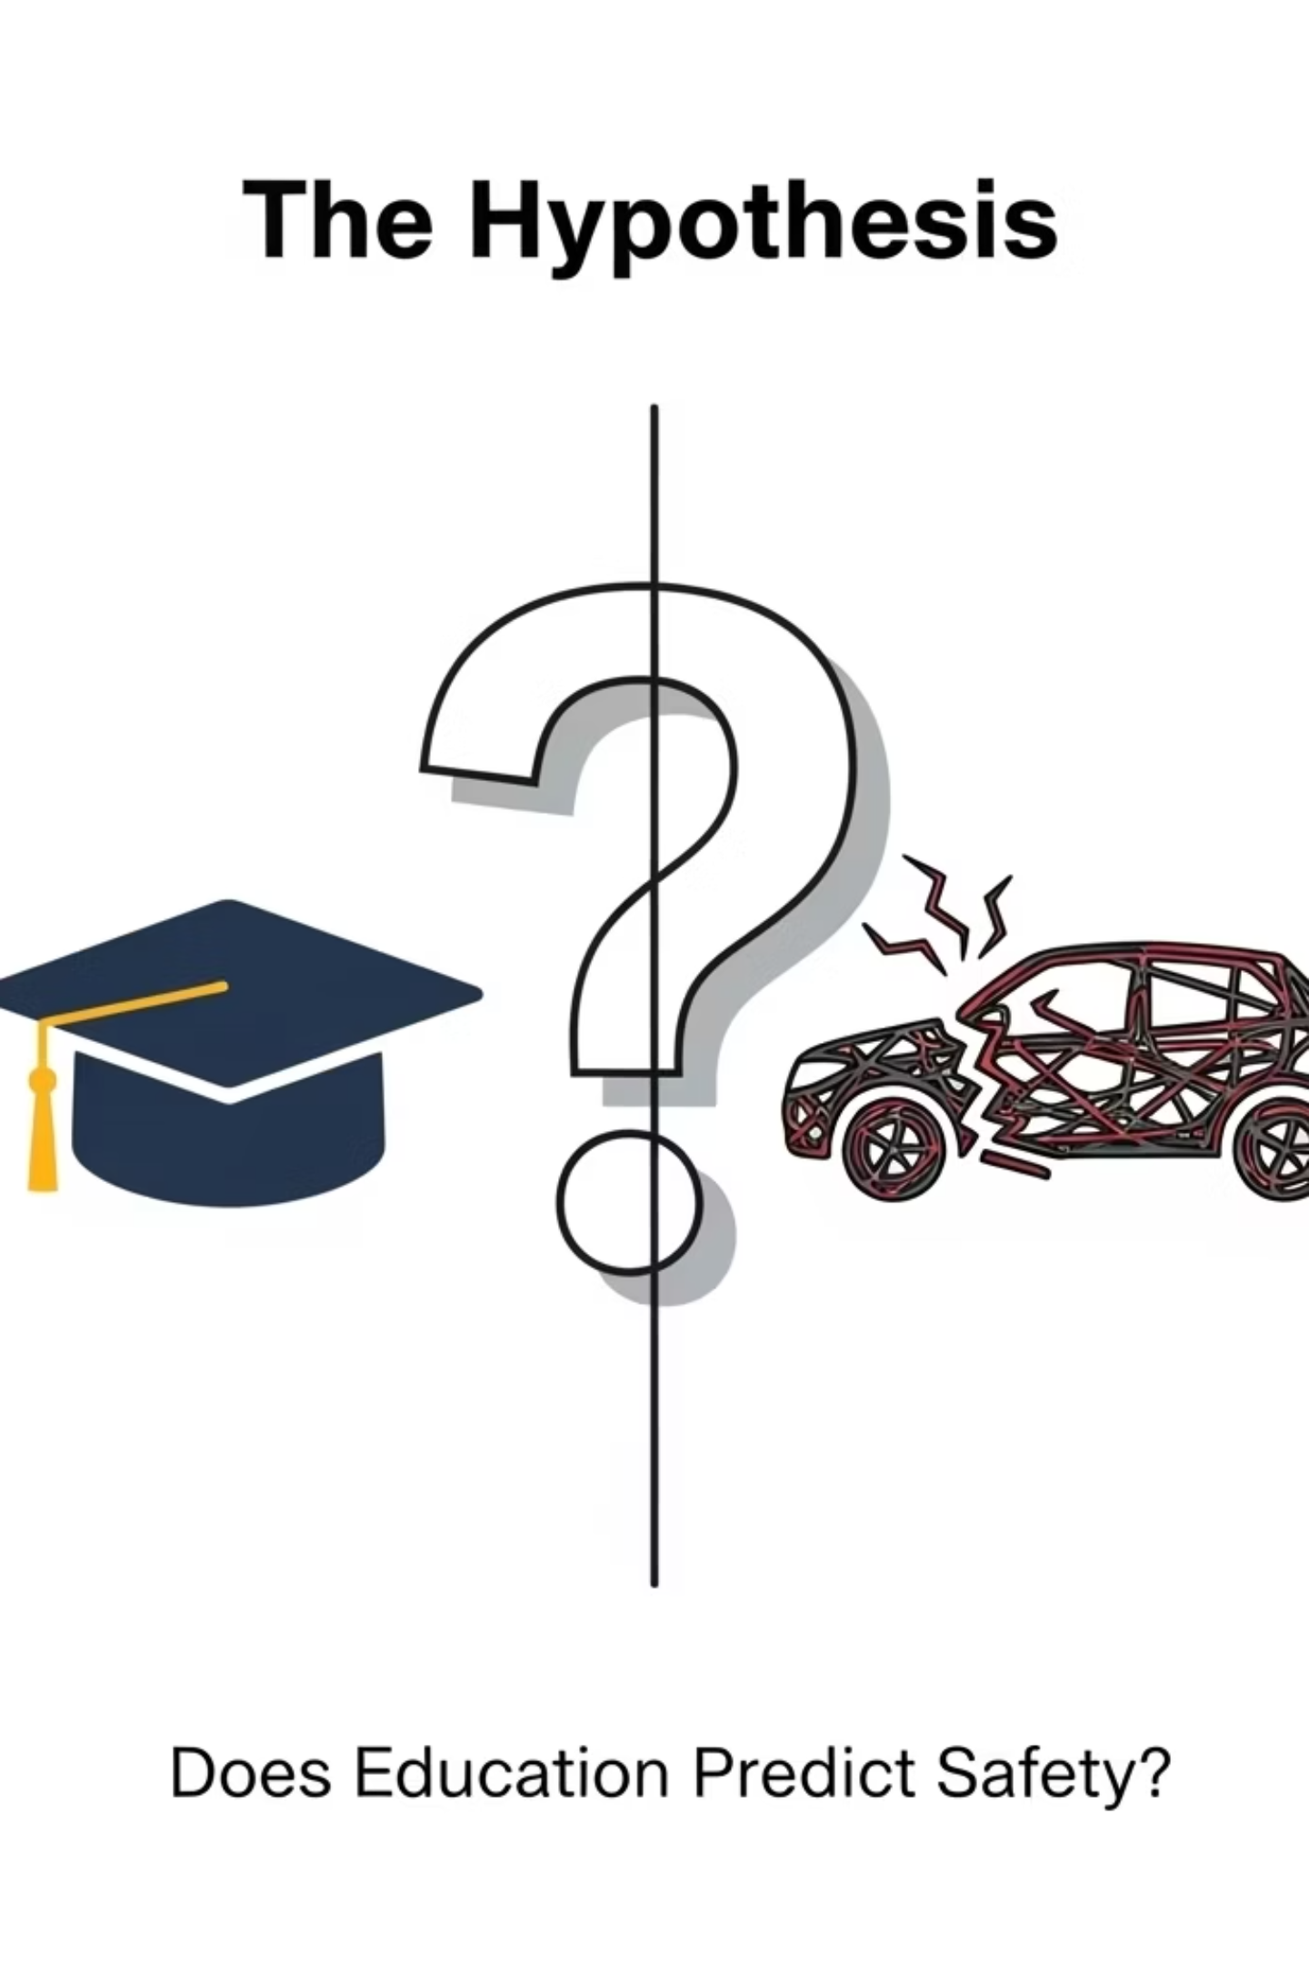
1
Does better Education lead to Lower Fatalities in road accidents?
Name | CMS
Muhammad Ali Imran | 455280
Nafeel Manan | 455323
Meerab Chaudary | 477284
Junaid Alam | 460371

Slide 2

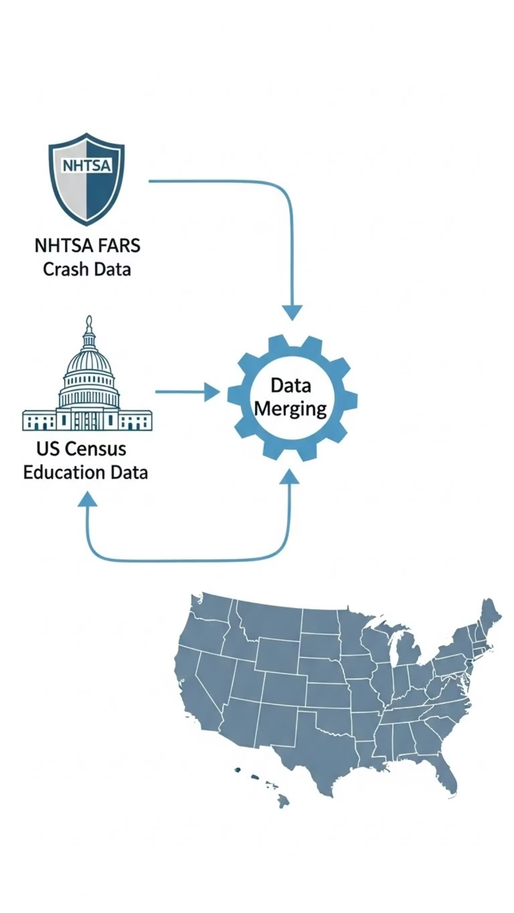
2
Our Data Pipeline:
NHTSA FARS
Over 14 years of detailed crash data, providing a deep historical perspective on incidents and fatalities.
US Census Bureau
Comprehensive education data, including high school graduation rates across various communities.
Data Merging & Standardization
Standardizing over 40,000 records to accurately link specific crash events to community-level educational attainment.
Integrated Geographical Dataset
The result: a robust, geocoded dataset allowing for precise spatial analysis of our variables.

Slide 3
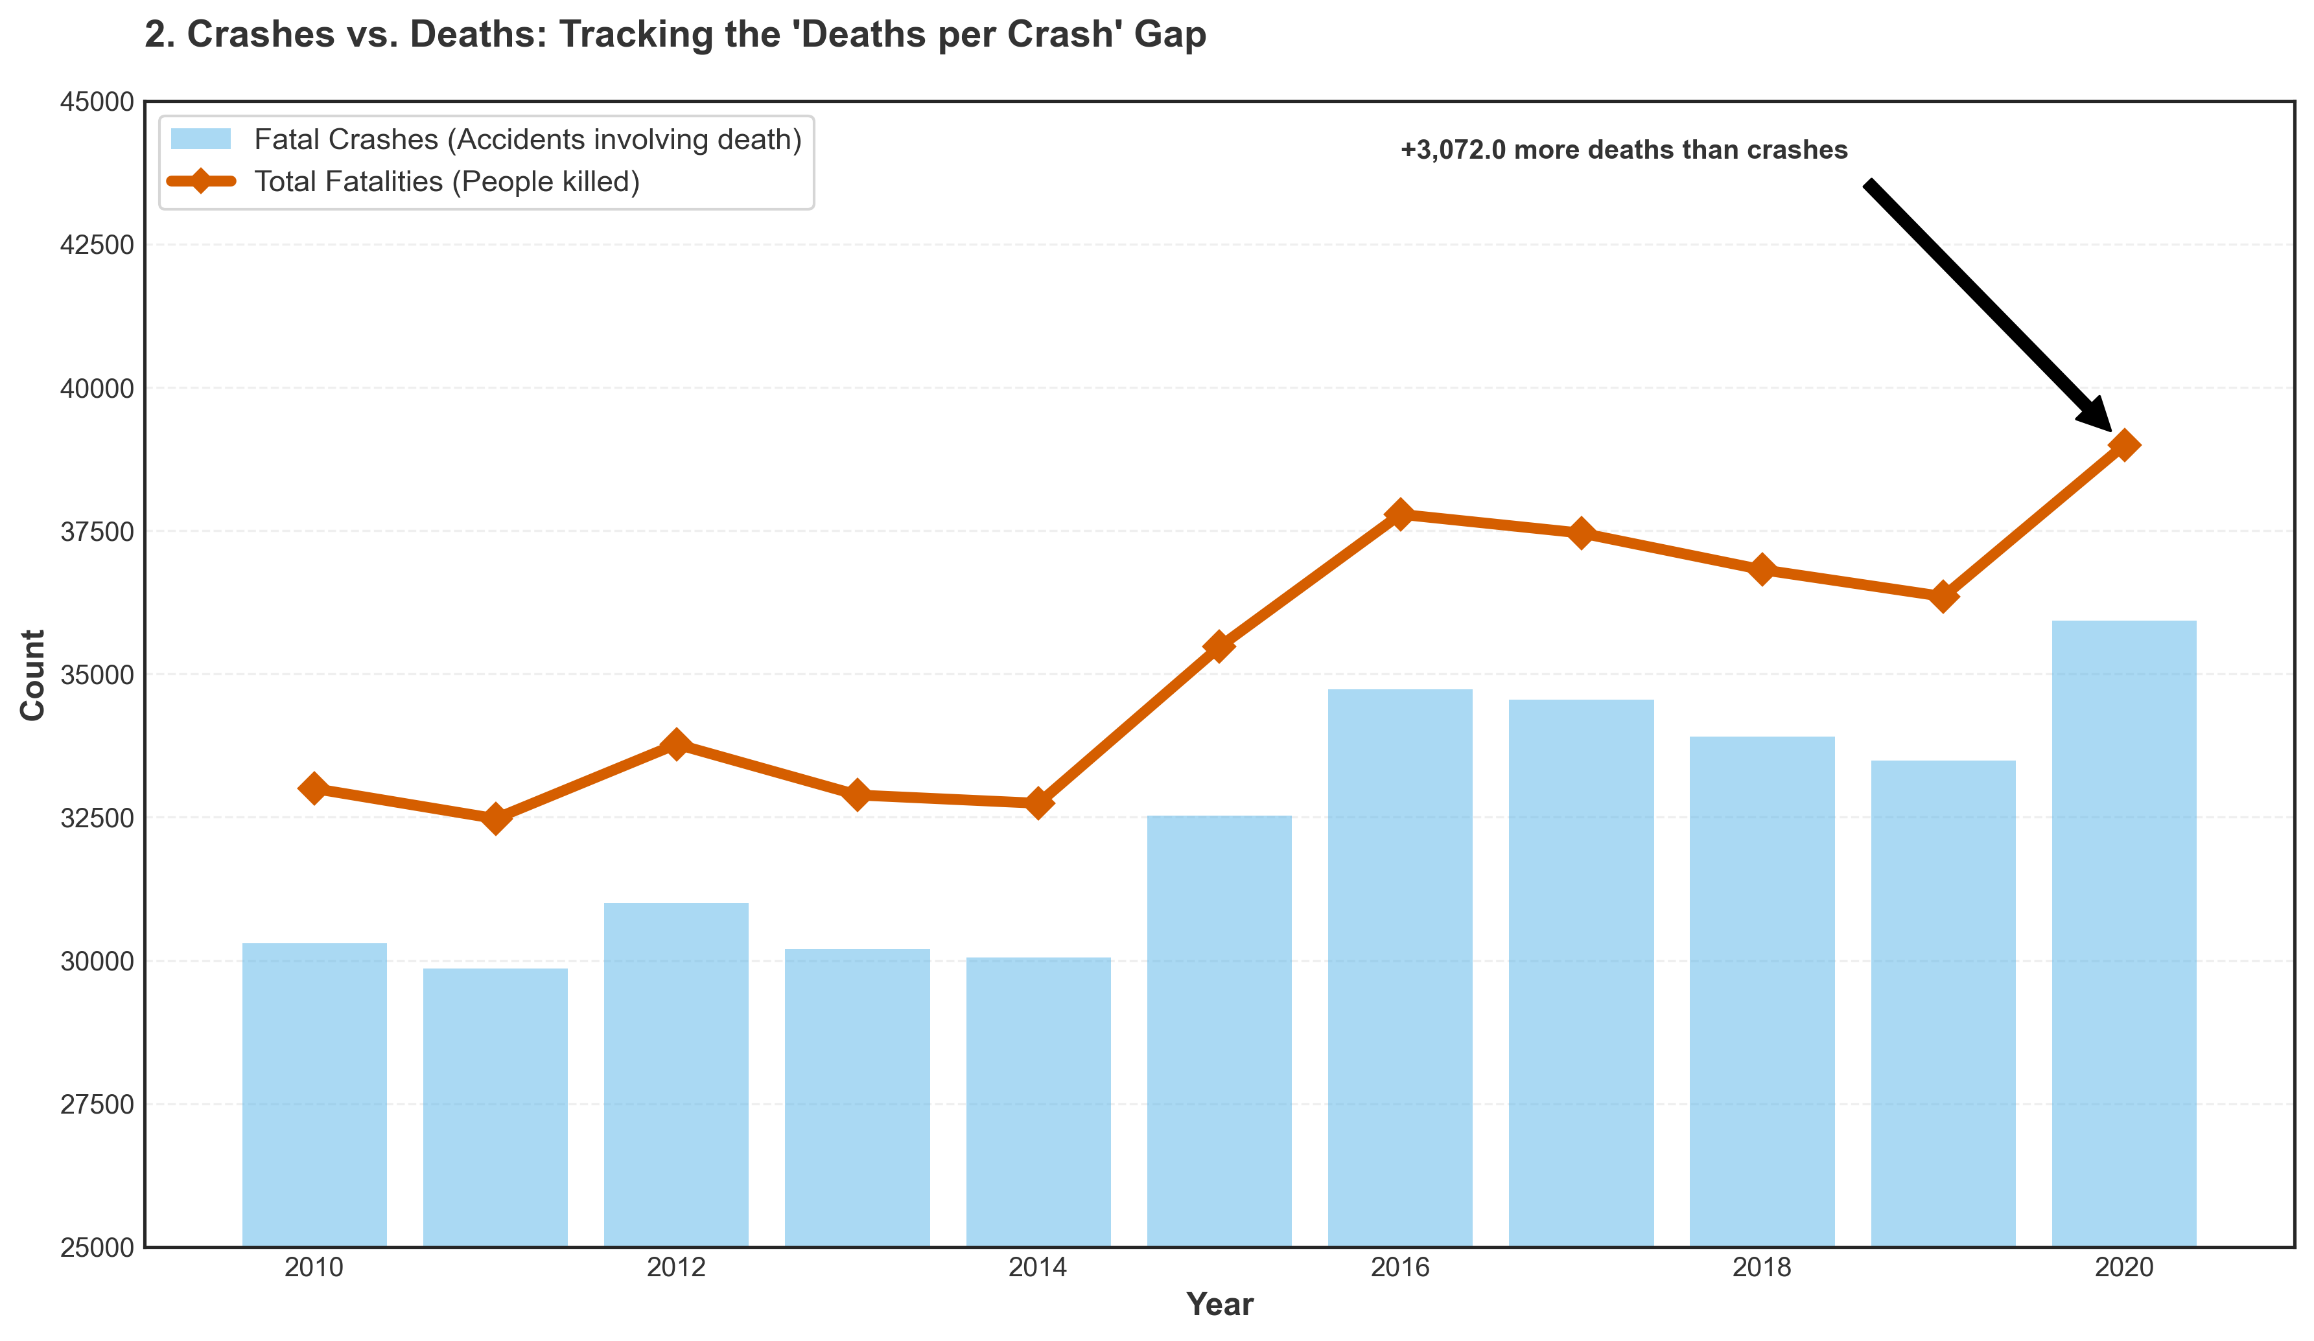
Rising Fatalities
3

Slide 4
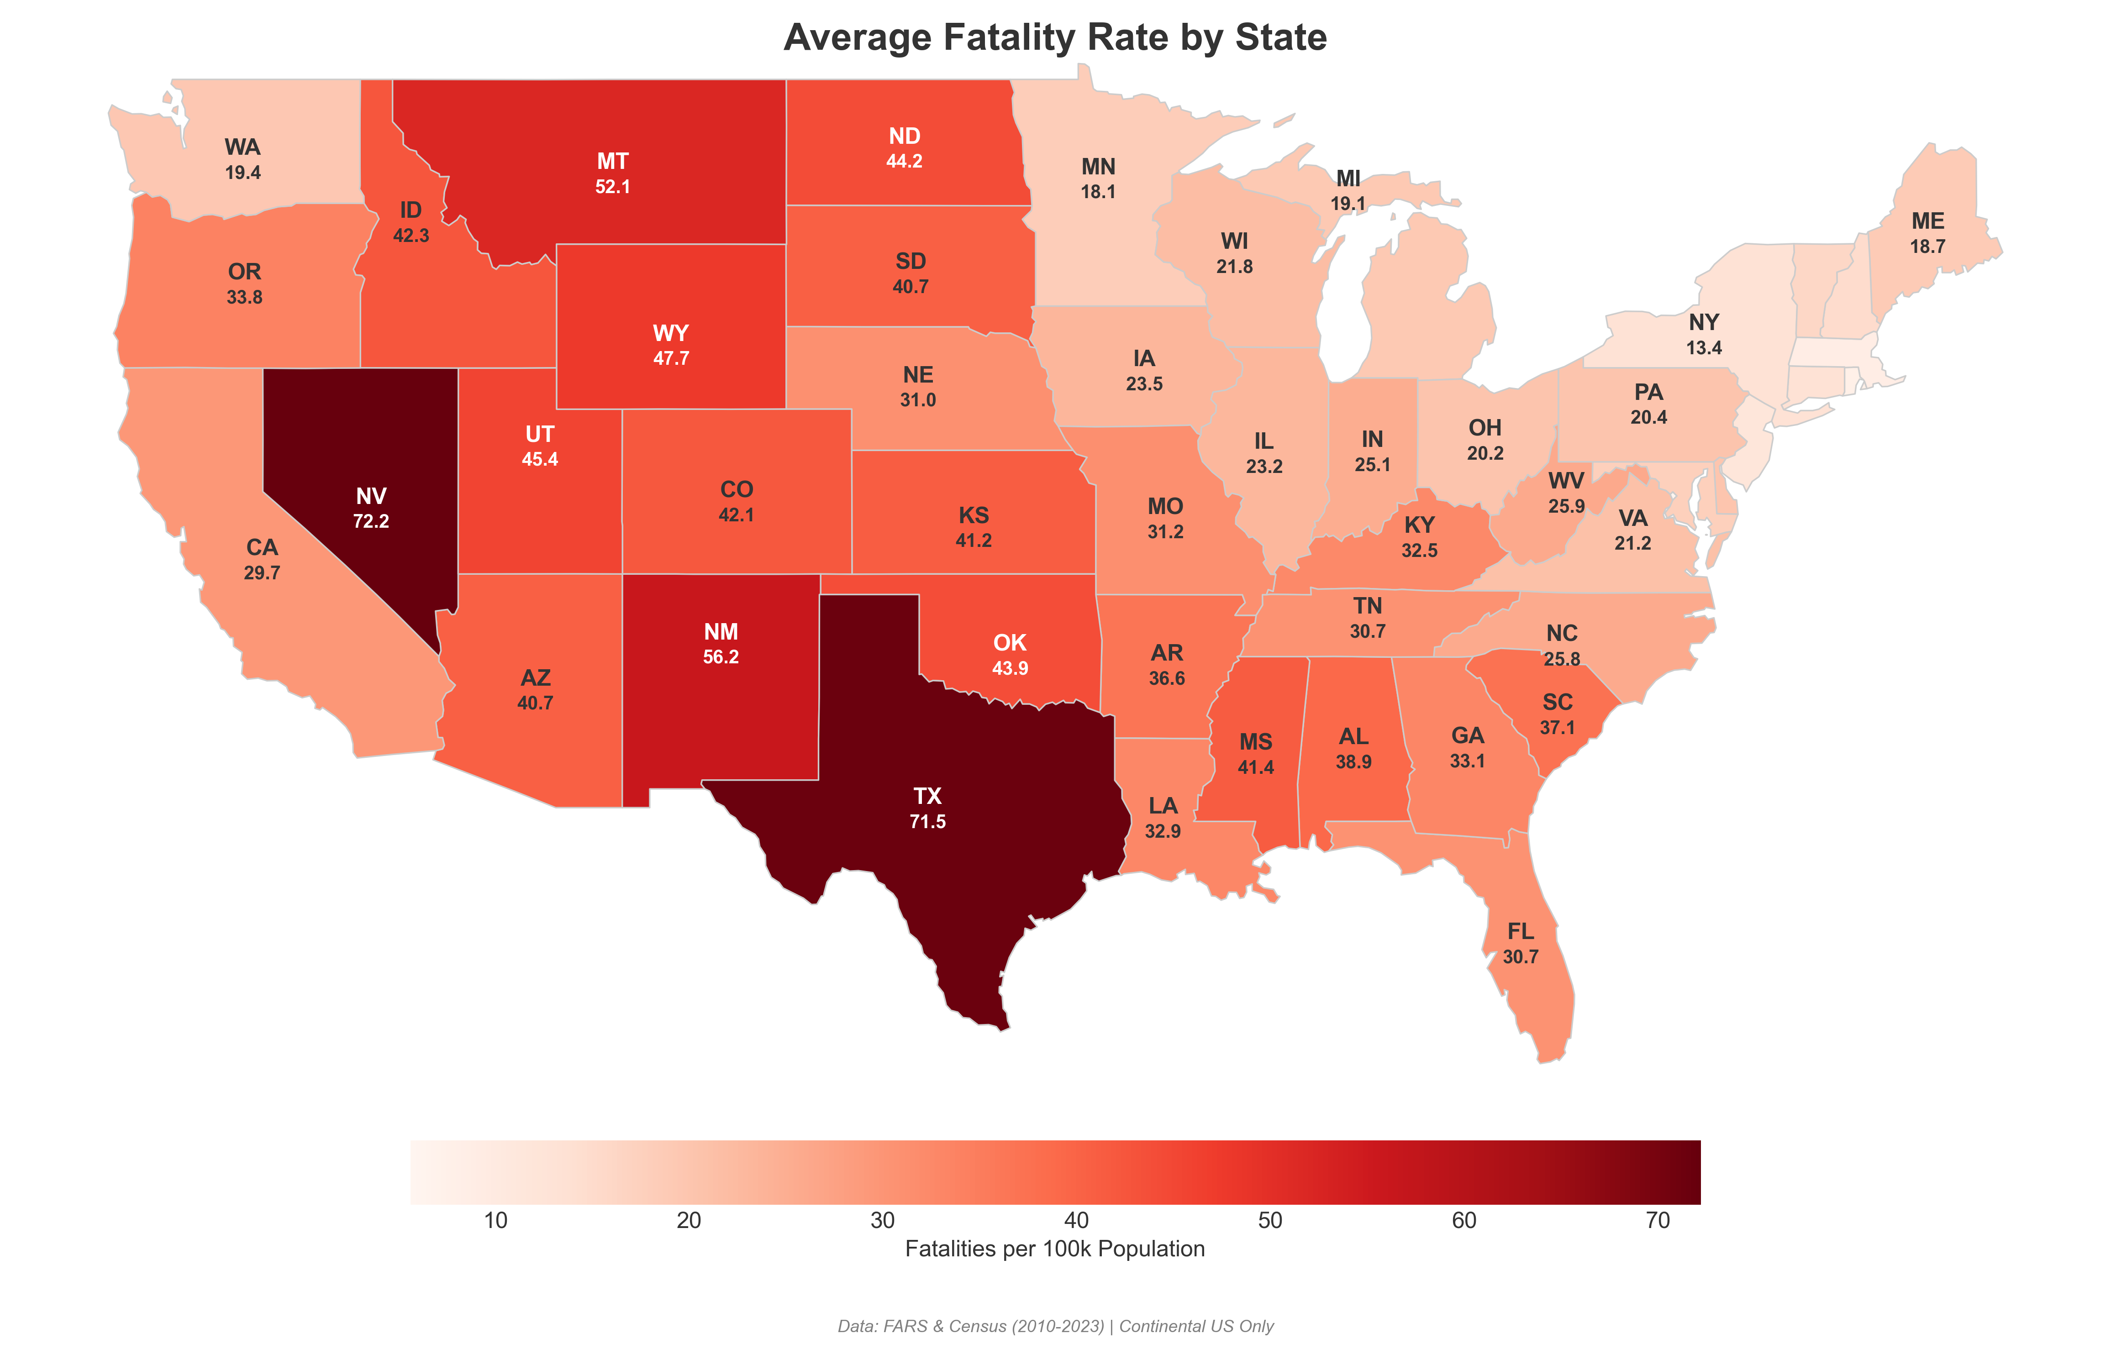
Where Fatalities Concentrate
4

Slide 5
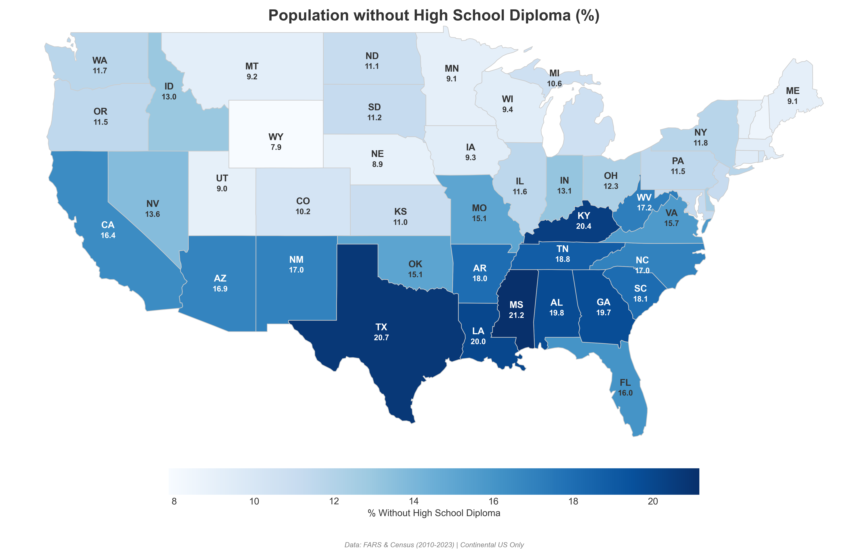
Education Levels Across the Nation
5

Slide 6
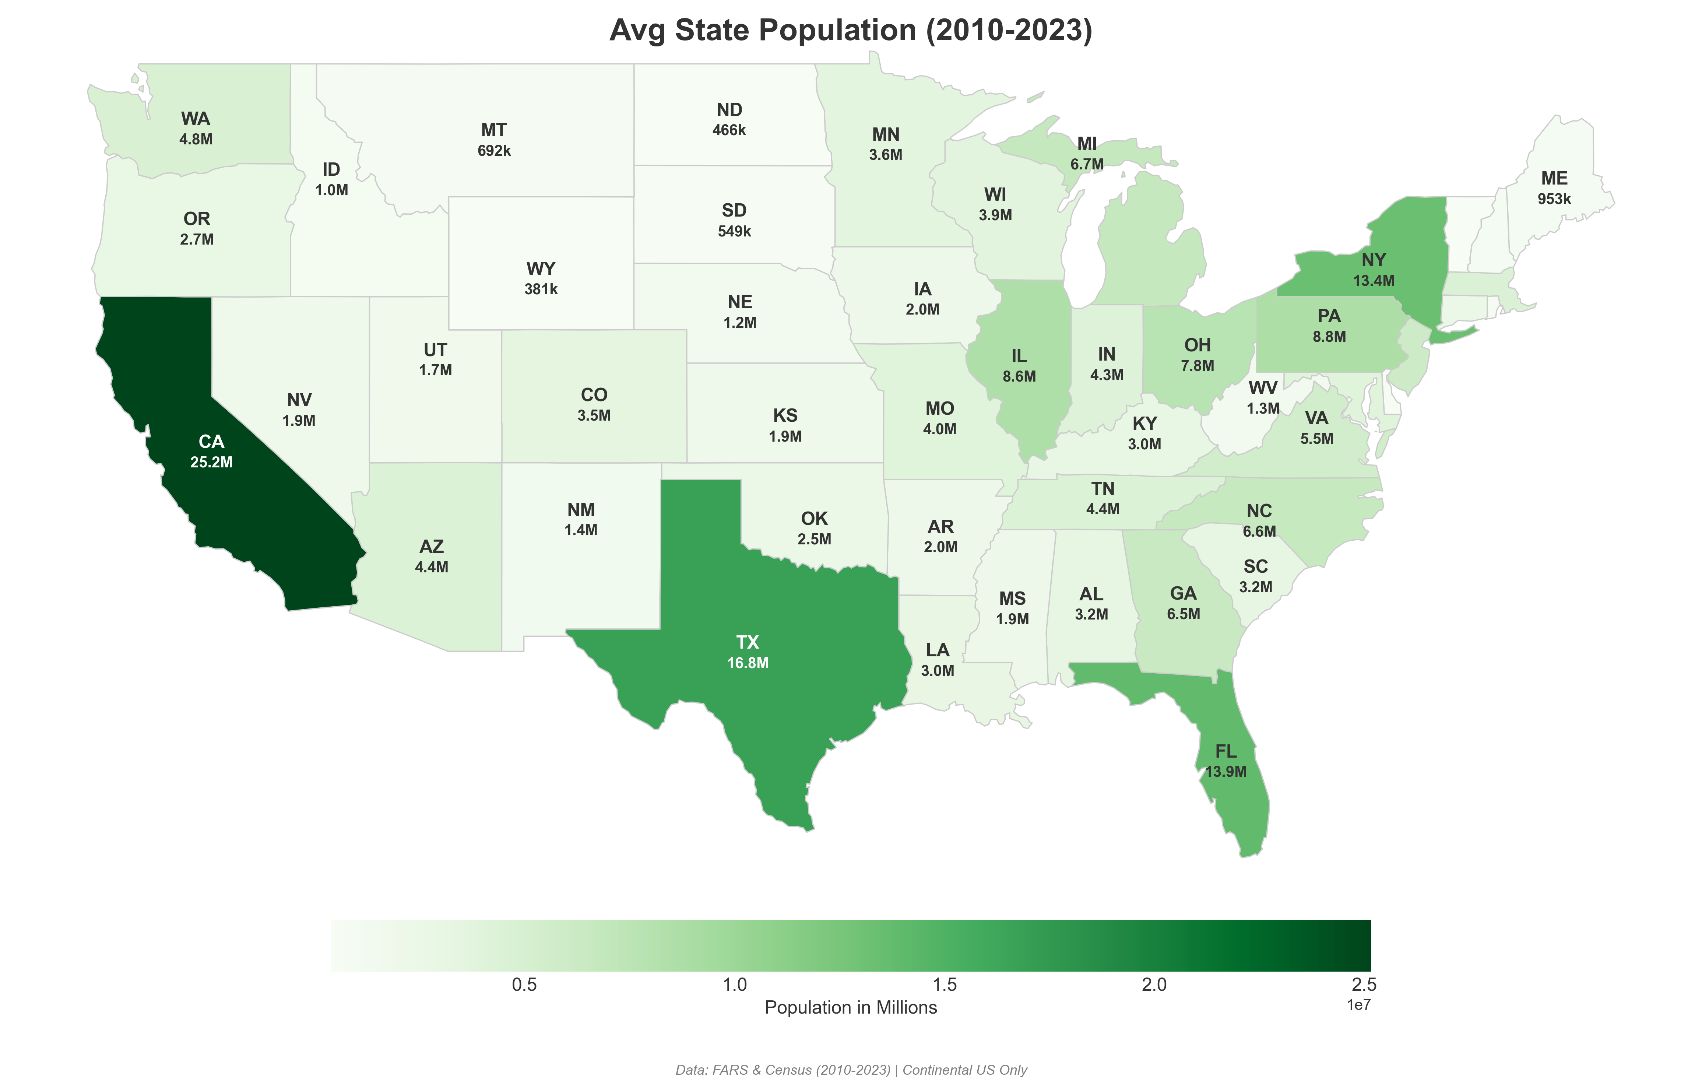
Population Map
6

Slide 7
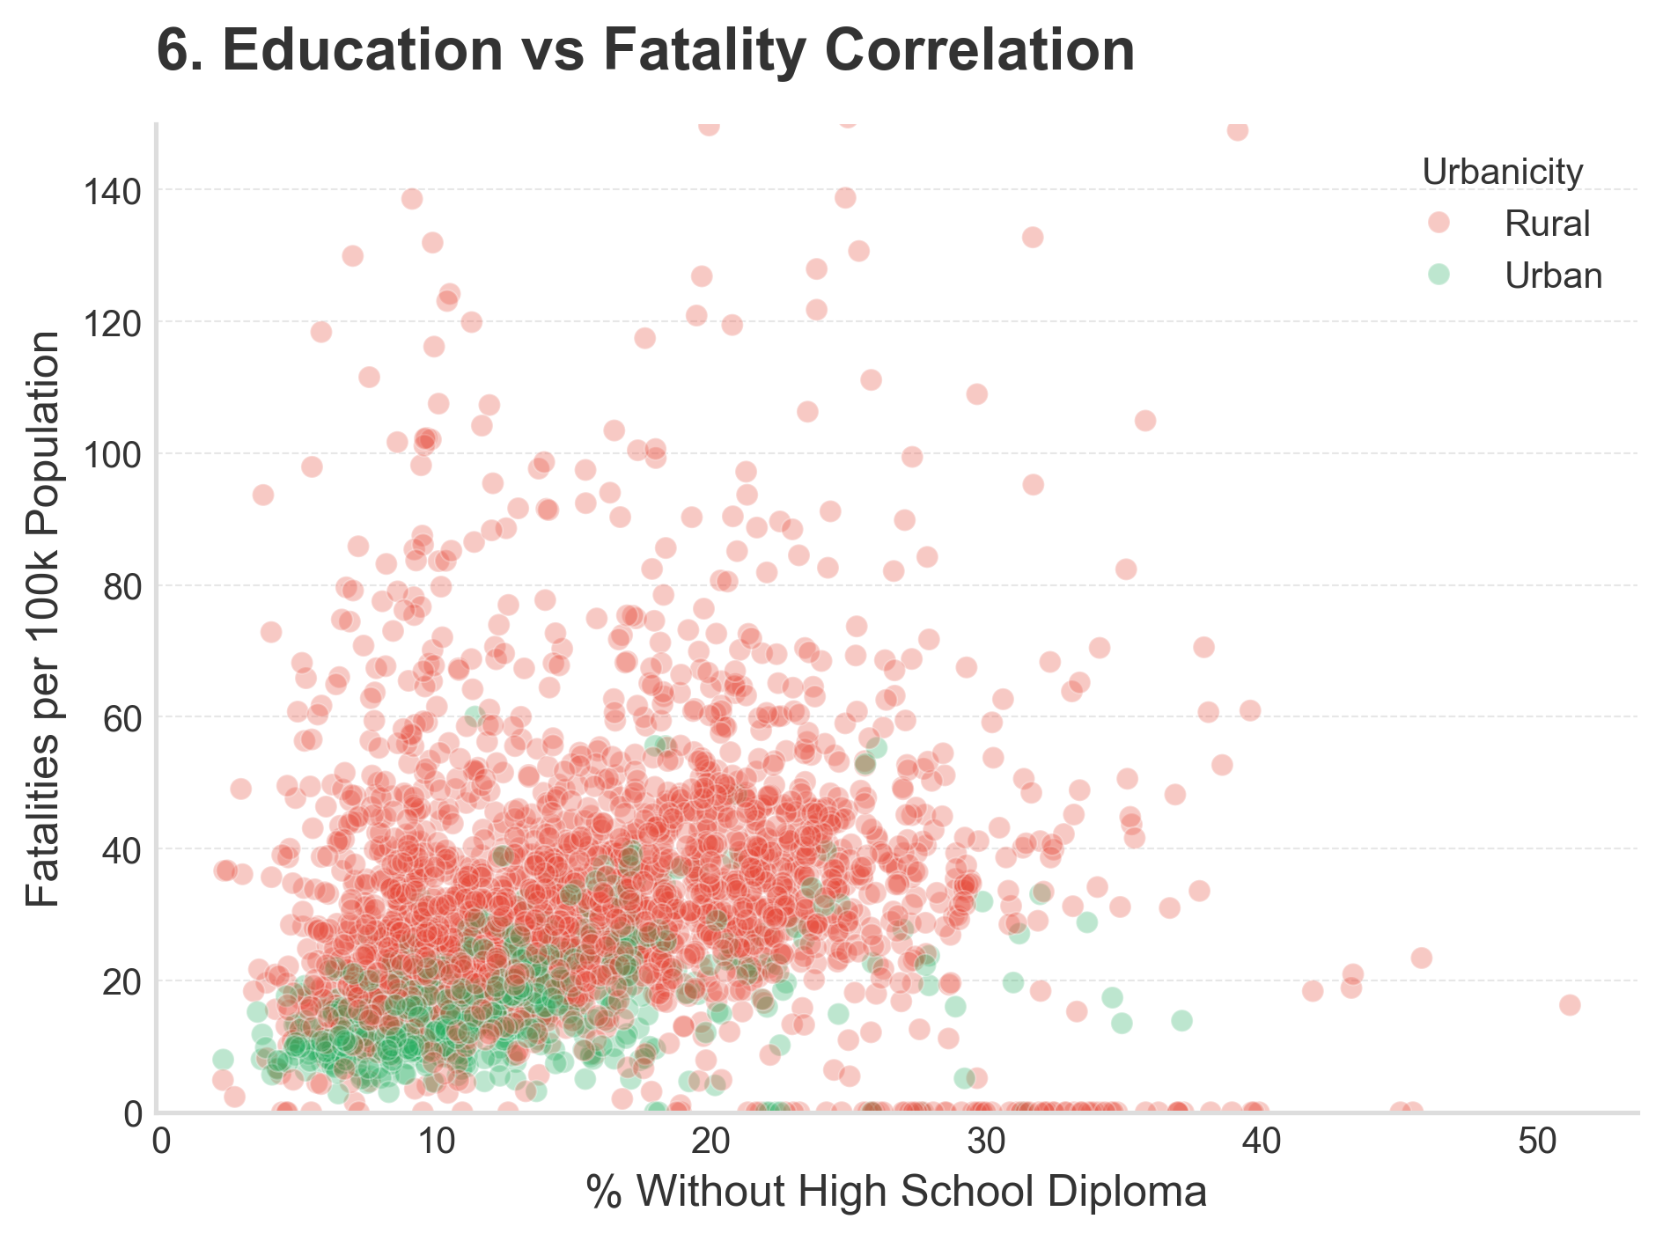
Statistical Confirmation
7

Slide 8
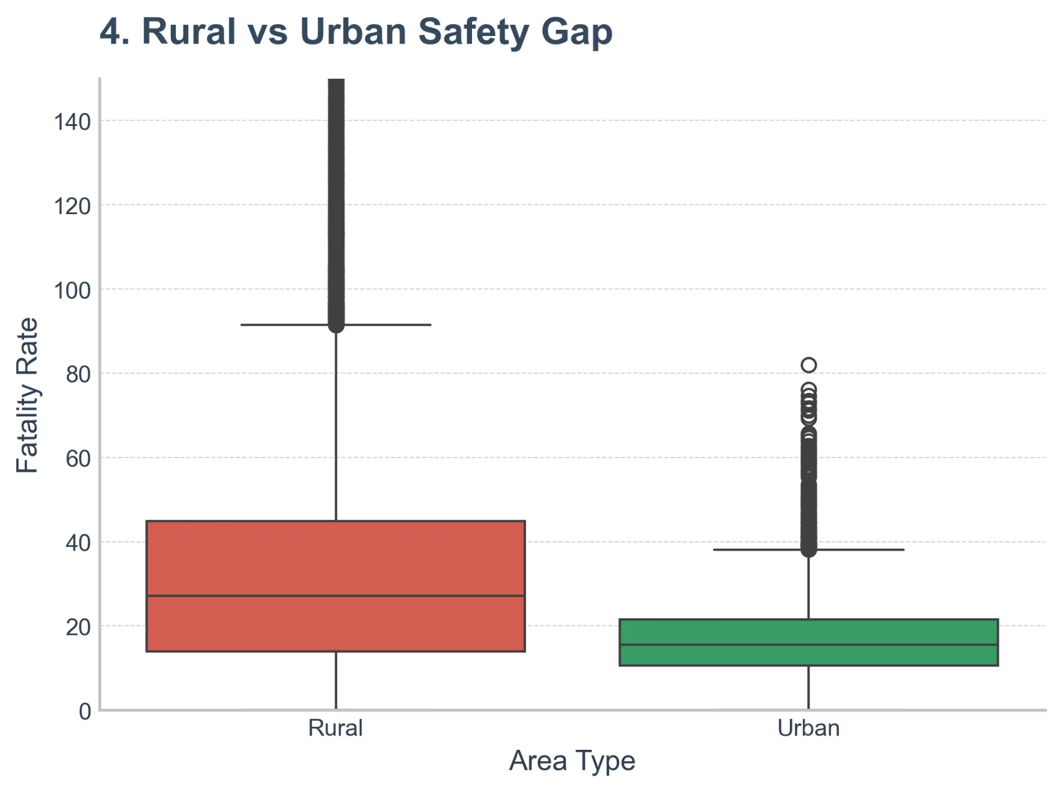


A 1.5x Greater Risk
8
To confirm the 'Rural Gap' theory, we conducted a quantitative analysis comparing fatality rates between rural and urban counties. The results were stark and undeniable.
Rural Counties
Consistently experience fatality rates 1.5 times higher than their urban counterparts.
Urban Counties
Benefit from better infrastructure, quicker emergency response, and more transportation options.
This box plot provides compelling evidence. Rural counties (marked in Red) exhibit fatality rates that are approximately 3 times more deadly than Urban counties (shown in Green). This clearly demonstrates that the environmental context—characterized by factors like longer travel distances and delayed access to critical medical care—is a major, independent driver of these tragic outcomes.

Slide 9
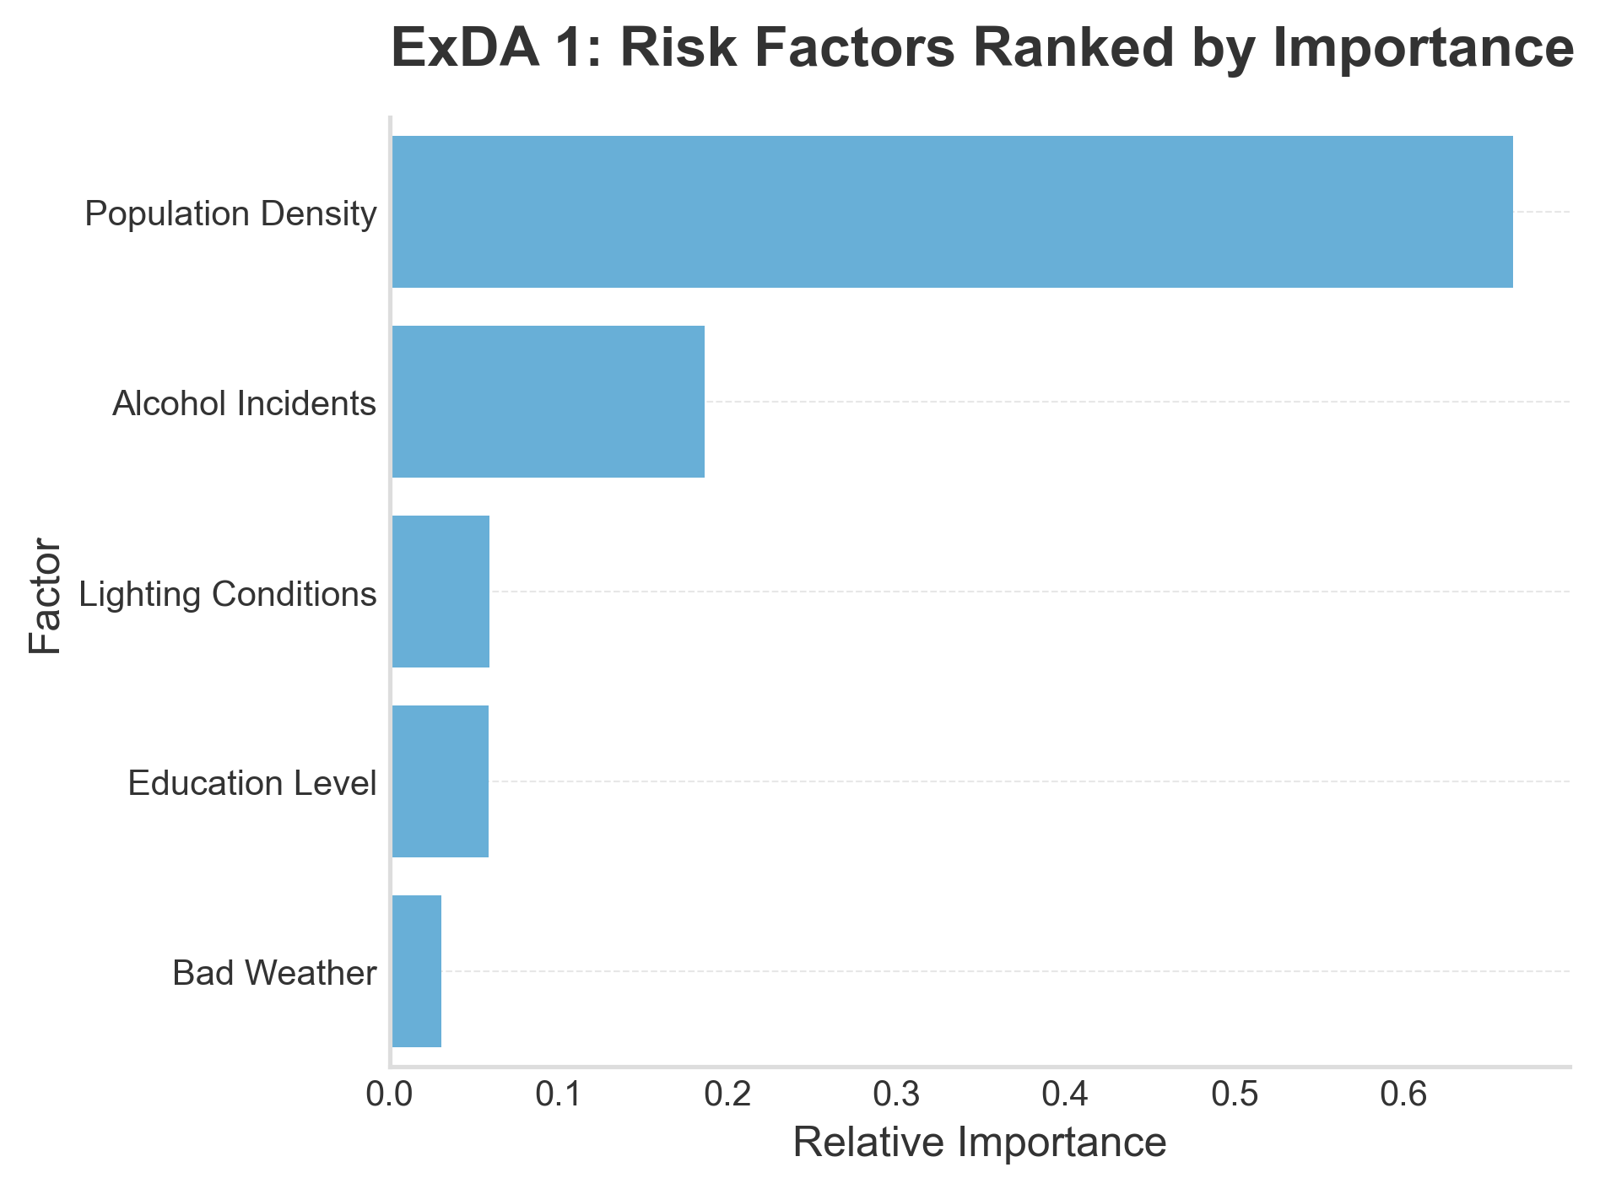
Ranking the driving factor
9

Slide 10
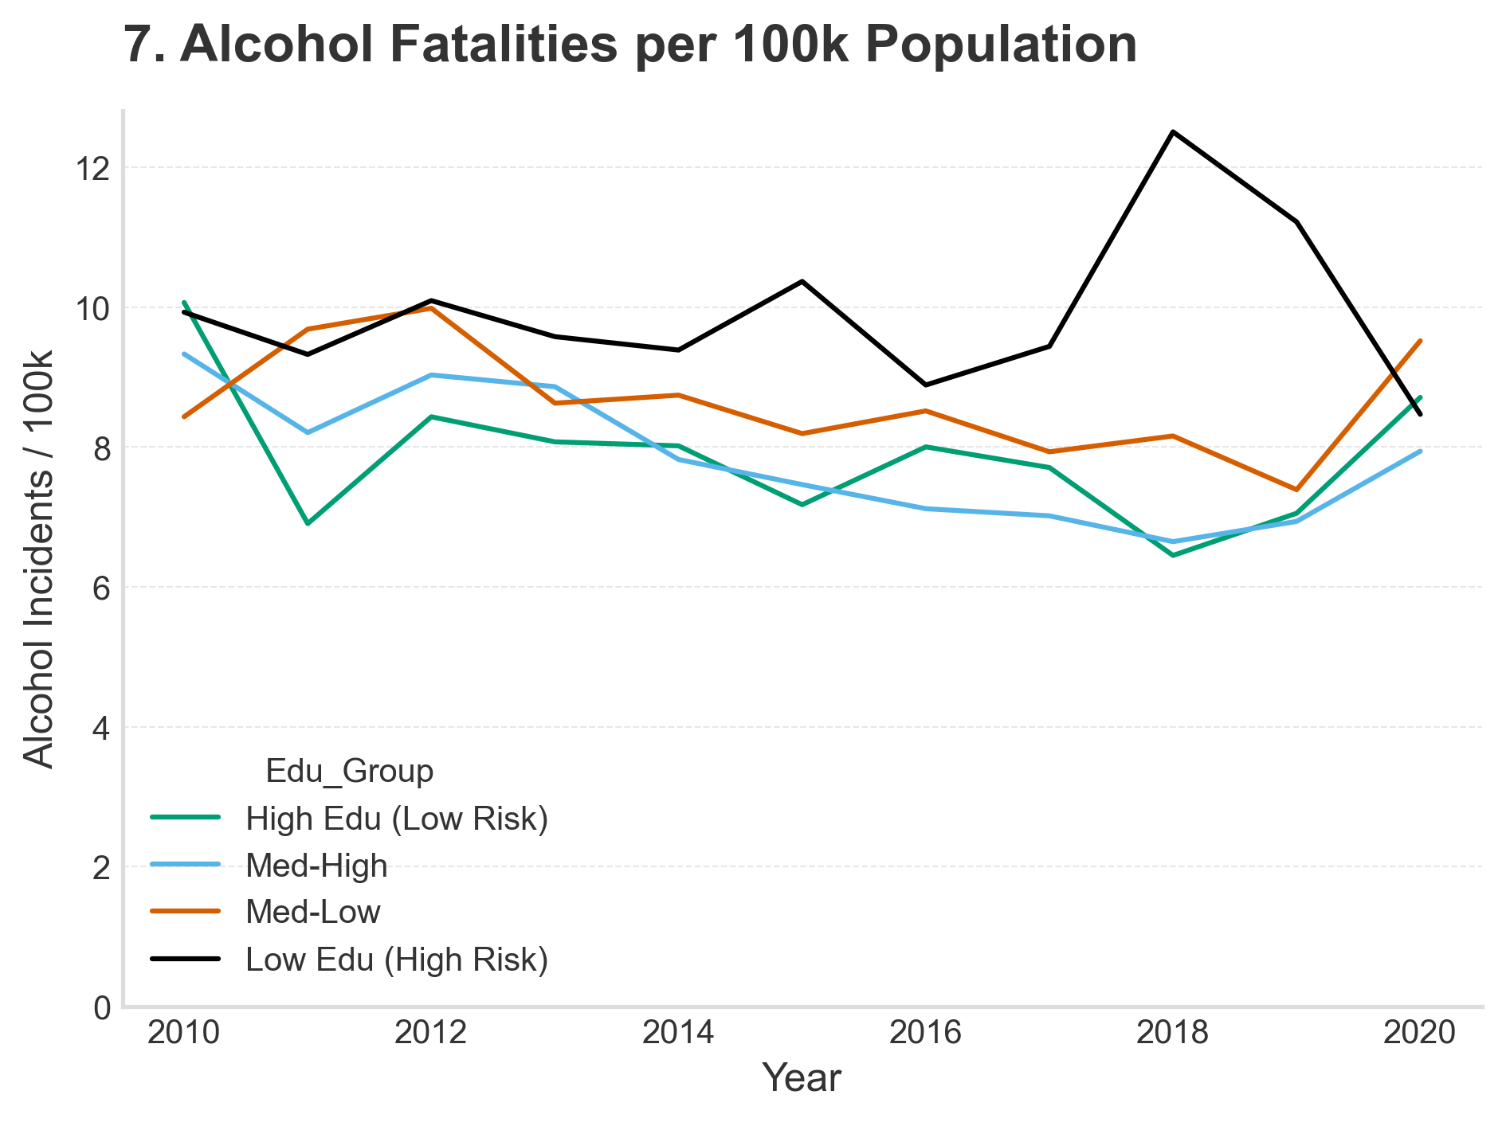
10
Alcohol related fatalities based on education level

Slide 11
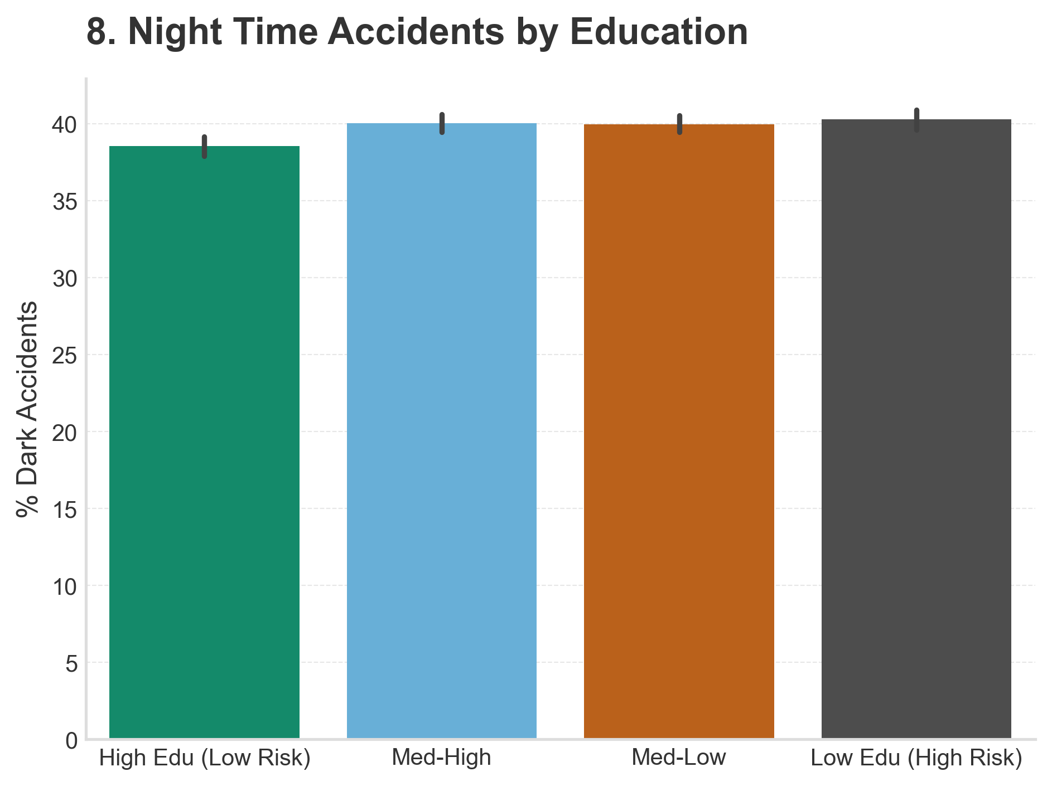
Investigating Environment
11
This chart shows accidents in the low lighting environment.
The Low Education counties (Right) have higher rates of night-time crashes.
This points to a lack of streetlights and infrastructure in these area.

Slide 12
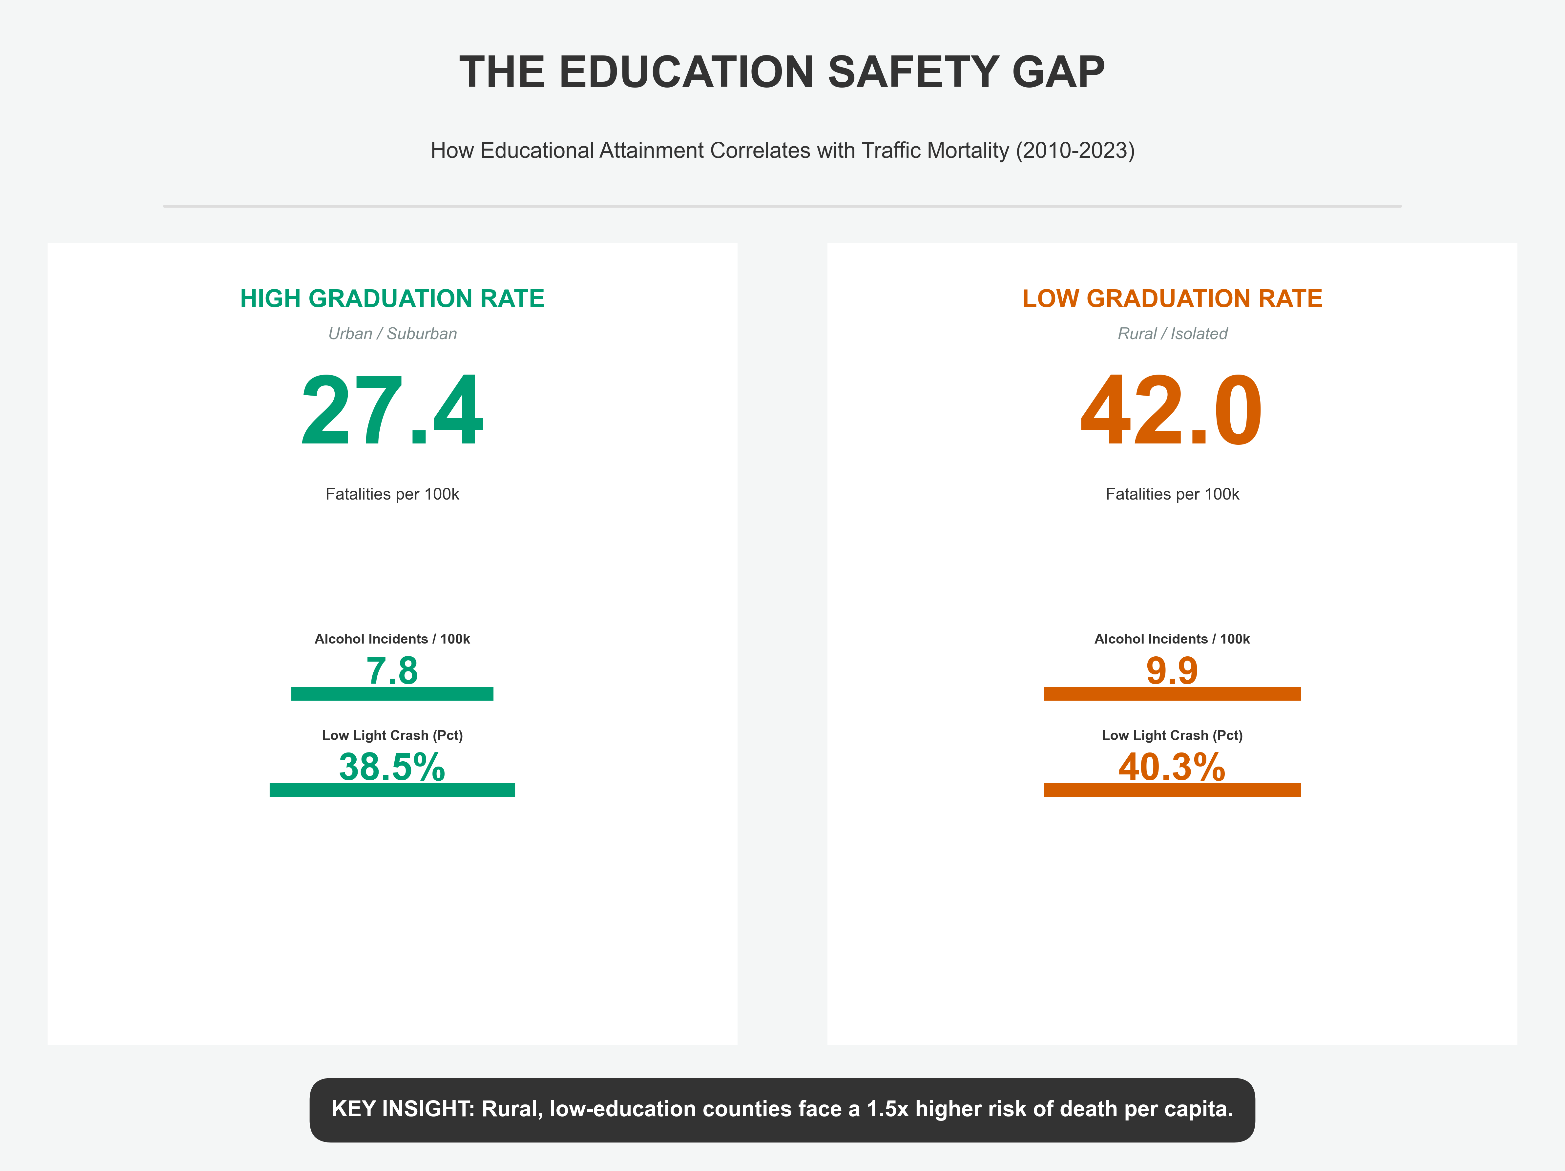


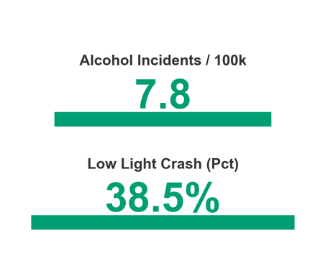
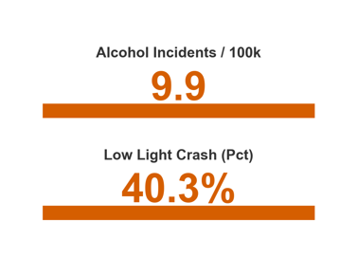

Summary of Findings
12
Fatalities per 100k
The top row compares fatalities per 100k population between high-education and low-education groups.
Alcohol Incidents
The middle row compares drunk driving incidents per 100k population across high- and low-education groups.
Low Light Incidents
The bottom row shows the share of fatal accidents occurring in dark conditions.

Slide 13


Conclusion on Hypothesis
13
So, was our hypothesis correct?
Communities with lower education levels do face higher risks. But here is the nuance: It is not because they are 'bad drivers’. It is because 'Low Education' in America correlates with 'Low Infrastructure’. These communities are being left behind.

Slide 14
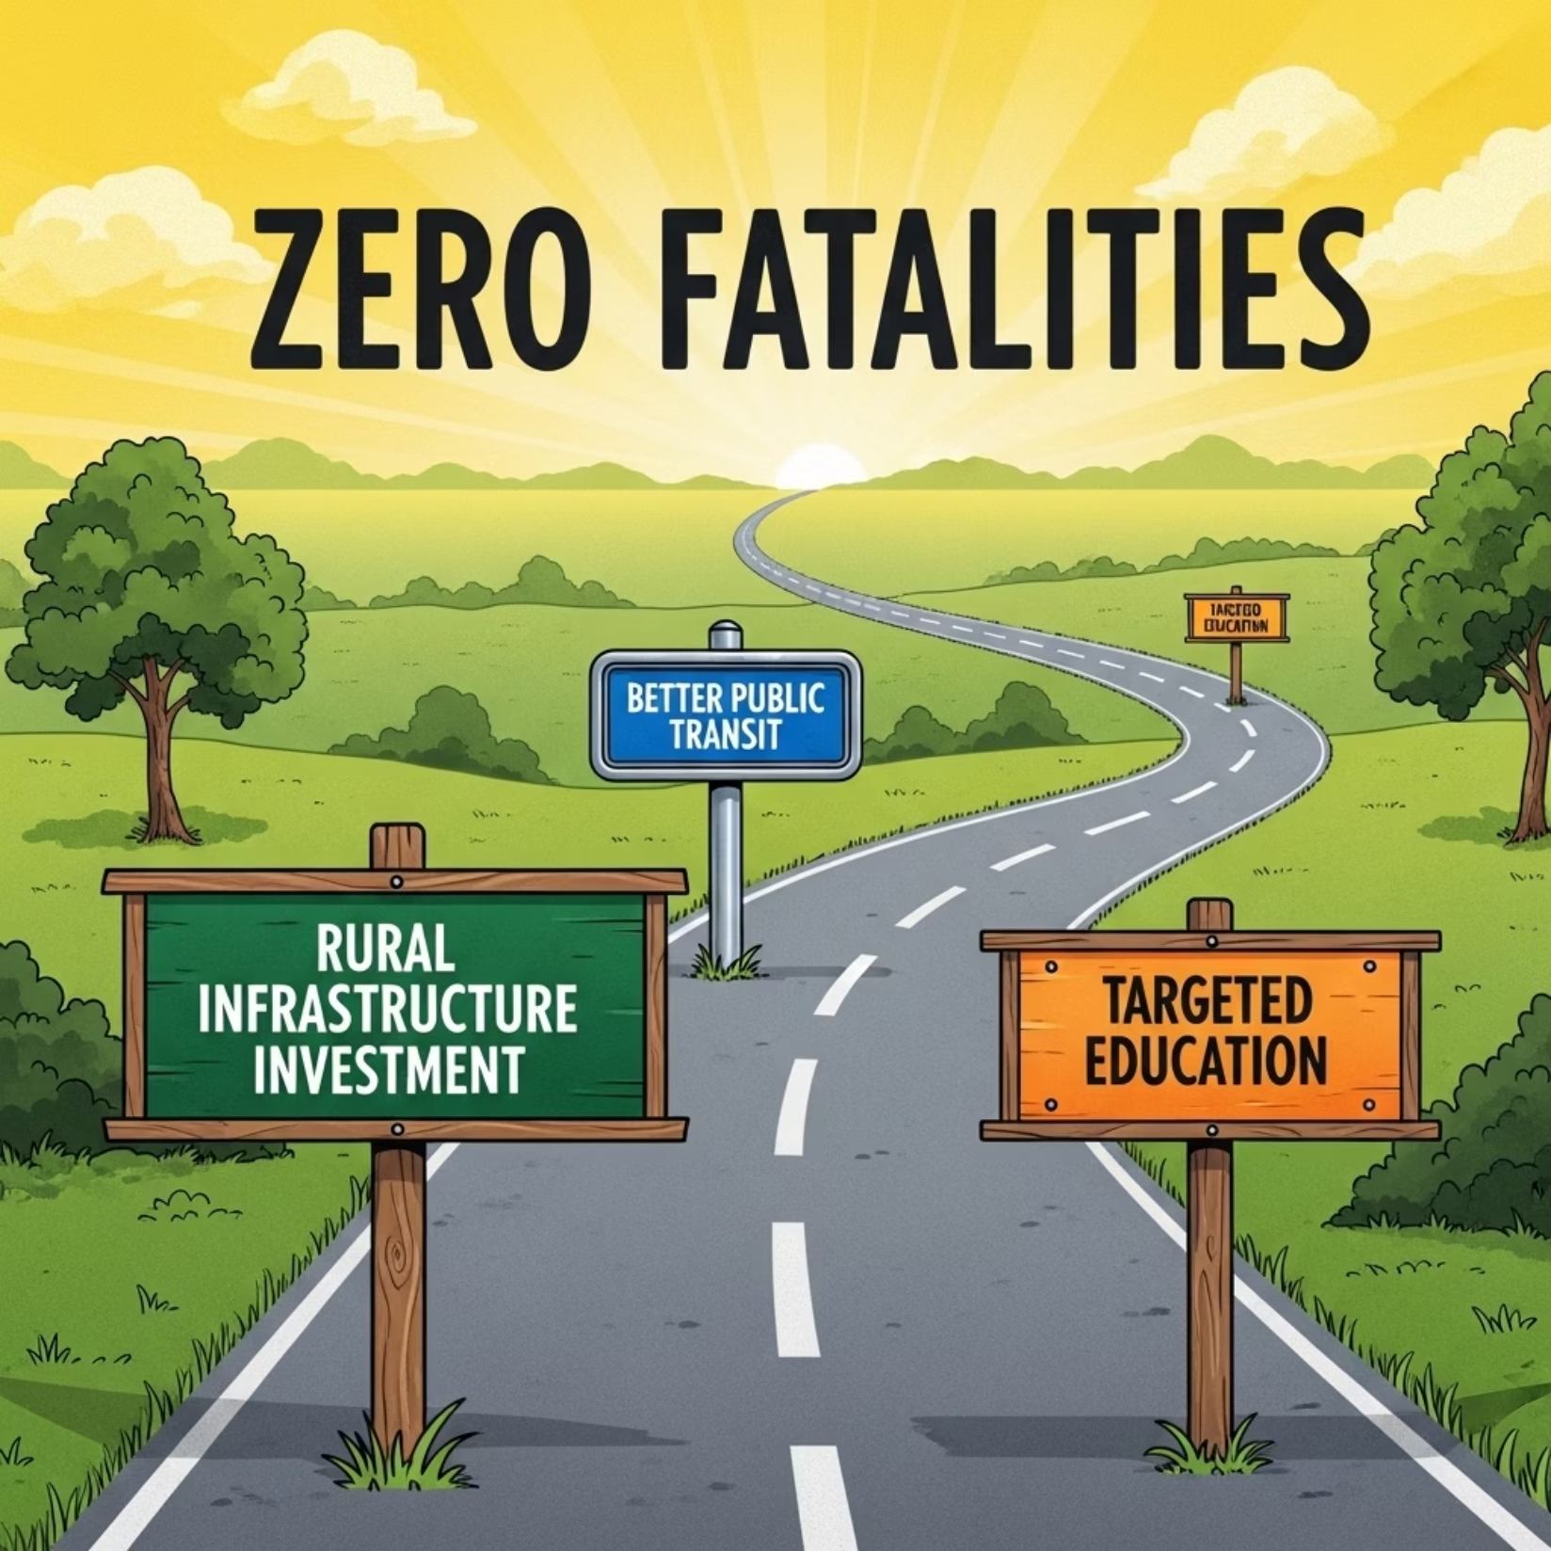
Recommendations
14
Our data journey ends with a call to action
To fix this, we don't just need safer cars. We need to invest in the rural communities identified in our maps providing them with the safer streets, medical access, and transport options they deserve. Thank you!

